Slide 1
Oral Cavity, Teeth, Tongue, and Salivary Glands
By: Ethan Leenstra

Slide 2
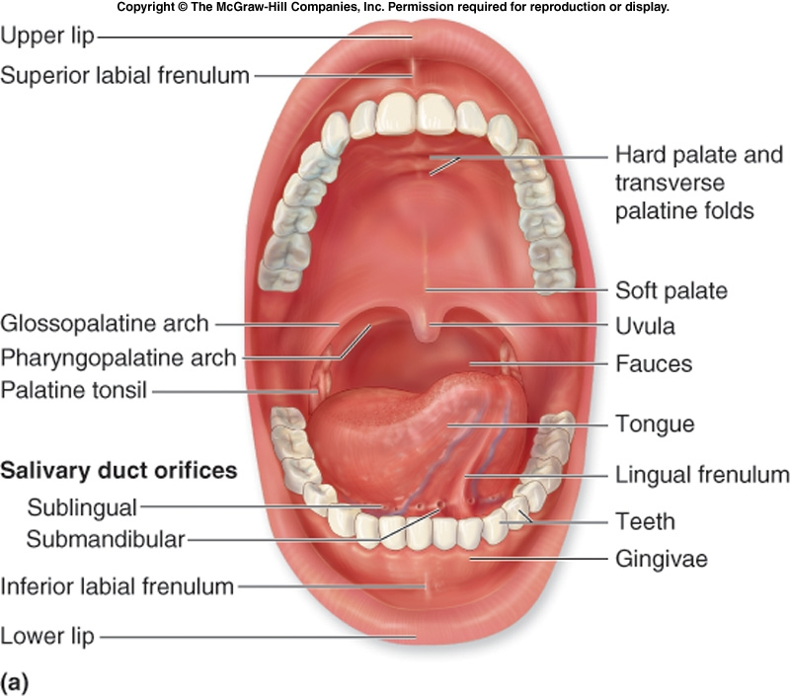
What is in the Oral Cavity?
The oral cavity (or mouth) consists of the teeth, tongue, salivary glands, cheeks, lips, palate (roof of the mouth), and the floor of the mouth
It also has a mucous lining membrane that protects the inside of the oral cavity
This set of organs are all a part of the digestive system and respiratory system

Slide 3
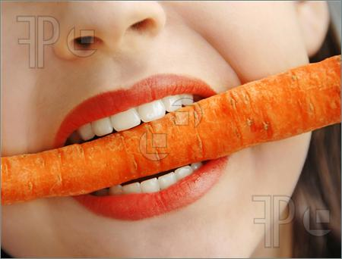
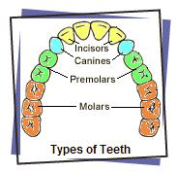
Teeth
Teeth do most of the physical breakdown in the digestive system by crushing and tearing food to be broken into smaller pieces
This process helps with the saturating of materials with salivary secretions and enzymes and it breaks connective tissue of meat and the plant fibres of vegetation
There are four types of teeth: incisors, canines, premolars, and molars

Slide 4
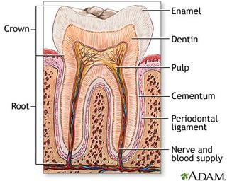
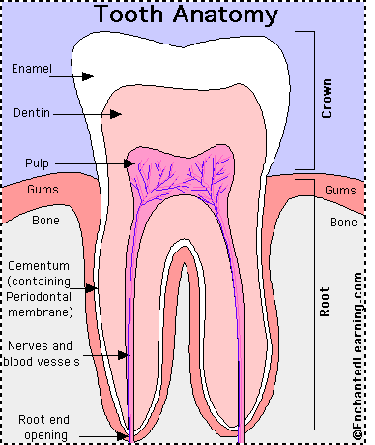
Teeth
The non-exposed part of the tooth is the root and the exposed is the crown (which is covered by enamel- the hardest substance of the body)
Most of the tooth is made from a mineralized matrix almost like bone called dentin
Another type of bony substance is the cementum which covers the root
There is a chamber on the inside of the tooth called the pulp cavity and it holds nerves and blood vessels that come through the root canal.
Root canal is a small tunnel at the bottom of the tooth

Slide 5
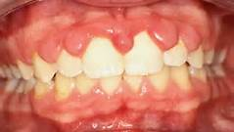
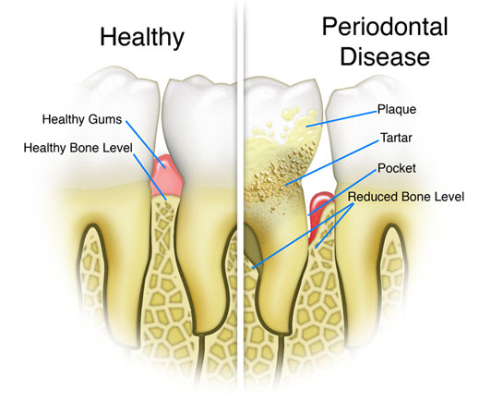
Teeth
Each root sits in a bony socket to hold it in place called the alveolus
Some issues with the teeth are: Gingivitis and Periodontal disease
Gingivitis-a disease that the cells in the gingivae (gums) break down and can lead to infections from bacteria
Periodontal disease-when the gums recede from the teeth to create erosion by bacteria going into the gums. This causes tooth loss

Slide 6
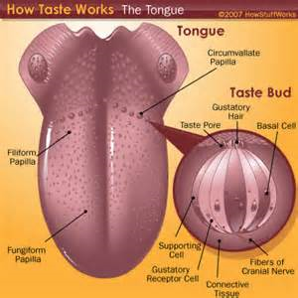
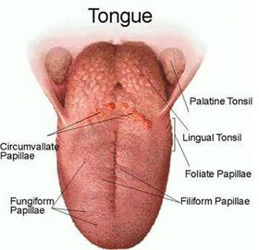
Tongue
The tongue helps in chewing, creates bolus, and prepares it for swallowing
Some other important things that the tongues does are:
secrete mucous and an enzyme lingual lipase
the mechanical processing of food through compression, abrasion, and distortion
And uses sensory analysis by taste receptors, touch, and temp.
The tongue is divided into 2 parts: the anterior body and the posterior root
The tongue also has two types of skeletal muscles: the intrinsic and extrinsic tongue muscles

Slide 7
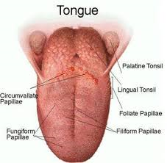
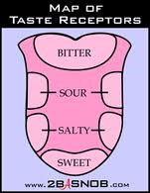
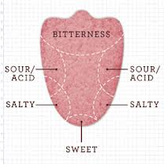
Tongue
On the surface of the oral part of the tongue, it contains lingual papillae ( which are hair like structures that give the tongue its rough texture)
There are 4 types of papillae: circumvallate, fungiform, filiform, and foliate papillae
All except the filiform papillae, have taste buds on them and they can detect sour, sweet, bitter, and salty
Along the lower midline of the tongue, there is a fold of mucous membrane called lingual frenulum, which connects the tongue to the floor of the oral cavity.

Slide 8
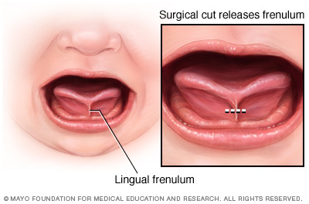
Tongue
Each of the papillae are covered in a thicker epithelium(a basic type of animal tissue), which helps in moving materials with the tongue
A condition that makes the lingual frenulum is too hard to allow the tongue to move and restricts speech and eating is called ankyloglossia

Slide 9
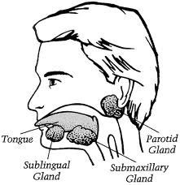
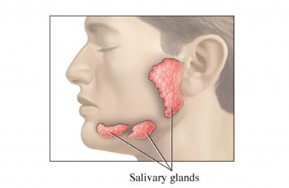
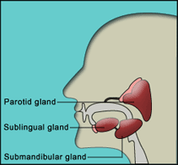
Salivary Glands
The salivary glands mainly make the mouth moist and also start the digestion of complex carbohydrates before swallowing
They also moist and lubricate food that is in the mouth and they also provide info about the material in the mouth. They can also dissolve chemicals that can stimulate the taste buds

Slide 10
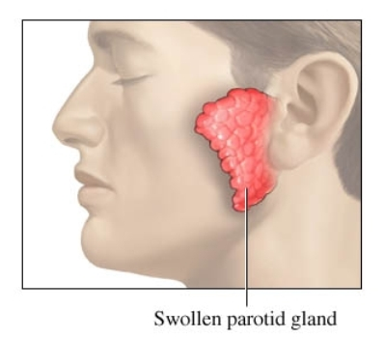
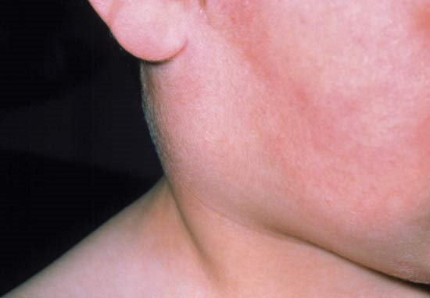
Salivary Glands
There are 3 types of salivary glands: Parotid salivary gland, Sublingual salivary glands, and the Submandibular salivary gland. Each gland has a different and irregular shape
These glands are surrounded by connective tissue and are internally separated by lobes
A condition that affects the salivary glands is the mumps virus. It is a swollen parotid gland

Slide 11
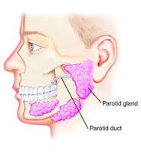
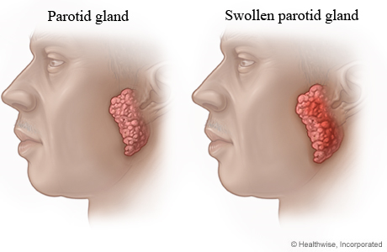
Parotid Salivary Gland
This gland secretes the amylase that breaks down carbs
These secretions are drained through the parotid duct and empties into a vestibule at the upper second molar
25% of saliva comes from this gland

Slide 12
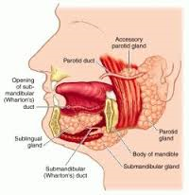
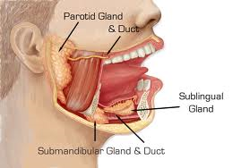
Sublingual Salivary Gland
It is on the floor of the oral cavity and it is covered in mucous membrane that lies on the gland
This gland creates a watery secretion that acts as a buffer and lubricant
The sublingual ducts open underneath lingual frenulum
5% of saliva is produced in this gland

Slide 13
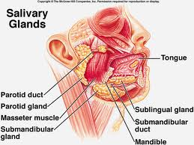
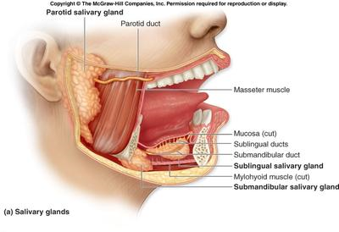
Submandibular Salivary Gland
This gland is found on the floor of the mouth in the mandibular groove, a dip in the inner area of the mandible
It creates a mixture of buffers, amylase, and glycoproteins called mucins
Submandibular ducts are opened right after the teeth, on either side of the lingual frenulum
This gland releases 70% of the saliva created in the body

Slide 14
Function of the Oral Cavity
The main function of the oral cavity is to begin digestion of food and materials. Also, a main part in breathing and swallowing.
It provides space for food and material to come in
The mouth chews it, and mixes it with saliva (which creates bolus). It then follows with the swallowing process by using peristales (which forces the food down the esophagus)
The lining in the mouth also creates lubrication , along with the salivary glands, make it easier to swallow, in speech, and digestion of materials and food

Slide 15
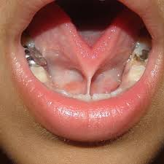
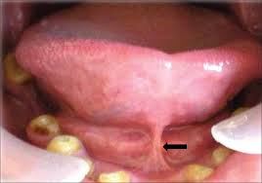
Ankyloglossia (Tongue-Tie)
This is a condition that restricts the movement and range of the tongue
With this disease, the lingual frenulum (piece of skin under tongue) restricts the movement of the tongue which can cause difficulty sticking their tongue out
Also can cause people to have trouble eating, swallowing, and breathing
Sometimes it can loosen on its own, but other times, it has to be surgically cut to remove issues of the patient
This affects the ability to function restricts the tongue’s ability to help swallow, eat, and breathe

Slide 16
Ankyloglossia (Tongue-Tie): Treatment
The only treatment for this condition is that the must cut it to ensure that the tongue is now free from any restriction
Other doctors say that the patients should just wait and see what will happen

Slide 17
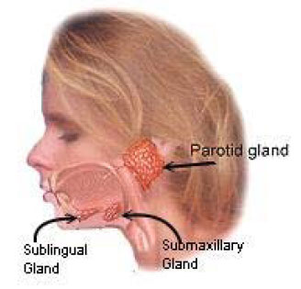
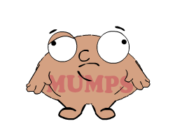
Mumps Virus
This is a disease that can affect many parts of the body, mainly the parotid salivary gland and it usually spreads through the saliva
This gland is located beneath the ear and above the jaw. And with this condition, it usually swells and causes pain
This affects the function of the glands because the glands swell and cause the gland not to produce saliva

Slide 18
Resources
http://www.ghorayeb.com/TongueTie.html
www.mayoclinic.com
www.cdc.gov
www.moldbacteriaconsulting.com
http://mackesanatomy.wikispaces.com/Oral+Cavity
http://www.cancer.ca/en/cancer-information/cancer-type/oral/anatomy-and-physiology/?region=on
http://www.nature.com/gimo/contents/pt1/full/gimo2.html
http://www.mayoclinic.com/health/tongue-tie/DS01200
http://kidshealth.org/parent/infections/bacterial_viral/mumps.html#

